Slide 1
Dashboard data visualisation

Slide 2
What data to display?
Temperature?
Humidity?
Noise Levels?
Difficult Things 2018 – Joris Lodewijks

Slide 3
What data to display?
Temperature?
Humidity?
Noise Levels?
They all have the same setup:
X-axis is a timestamp
Y-axis is the data point
Difficult Things 2018 – Joris Lodewijks

Slide 4
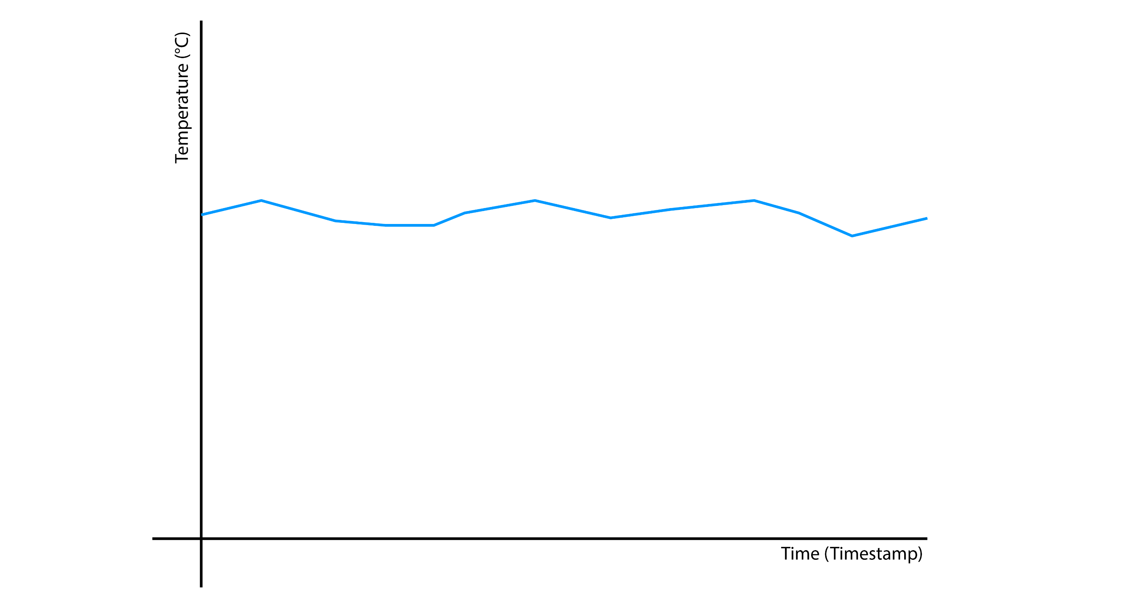
Difficult Things 2018 – Joris Lodewijks

Slide 5
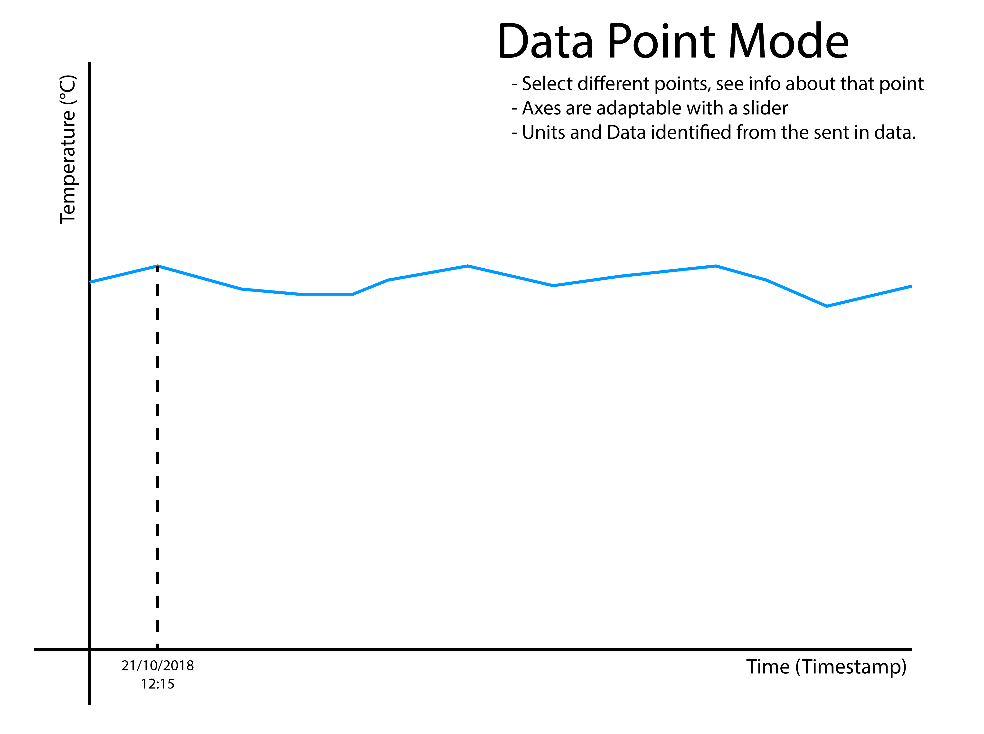
Difficult Things 2018 – Joris Lodewijks

Slide 6
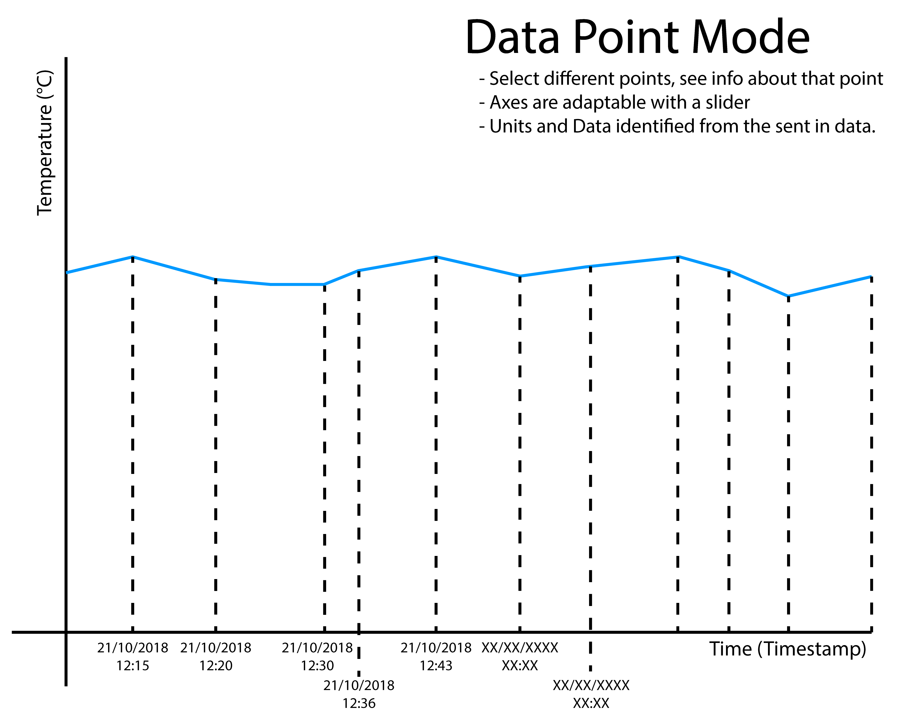
Difficult Things 2018 – Joris Lodewijks

Slide 7
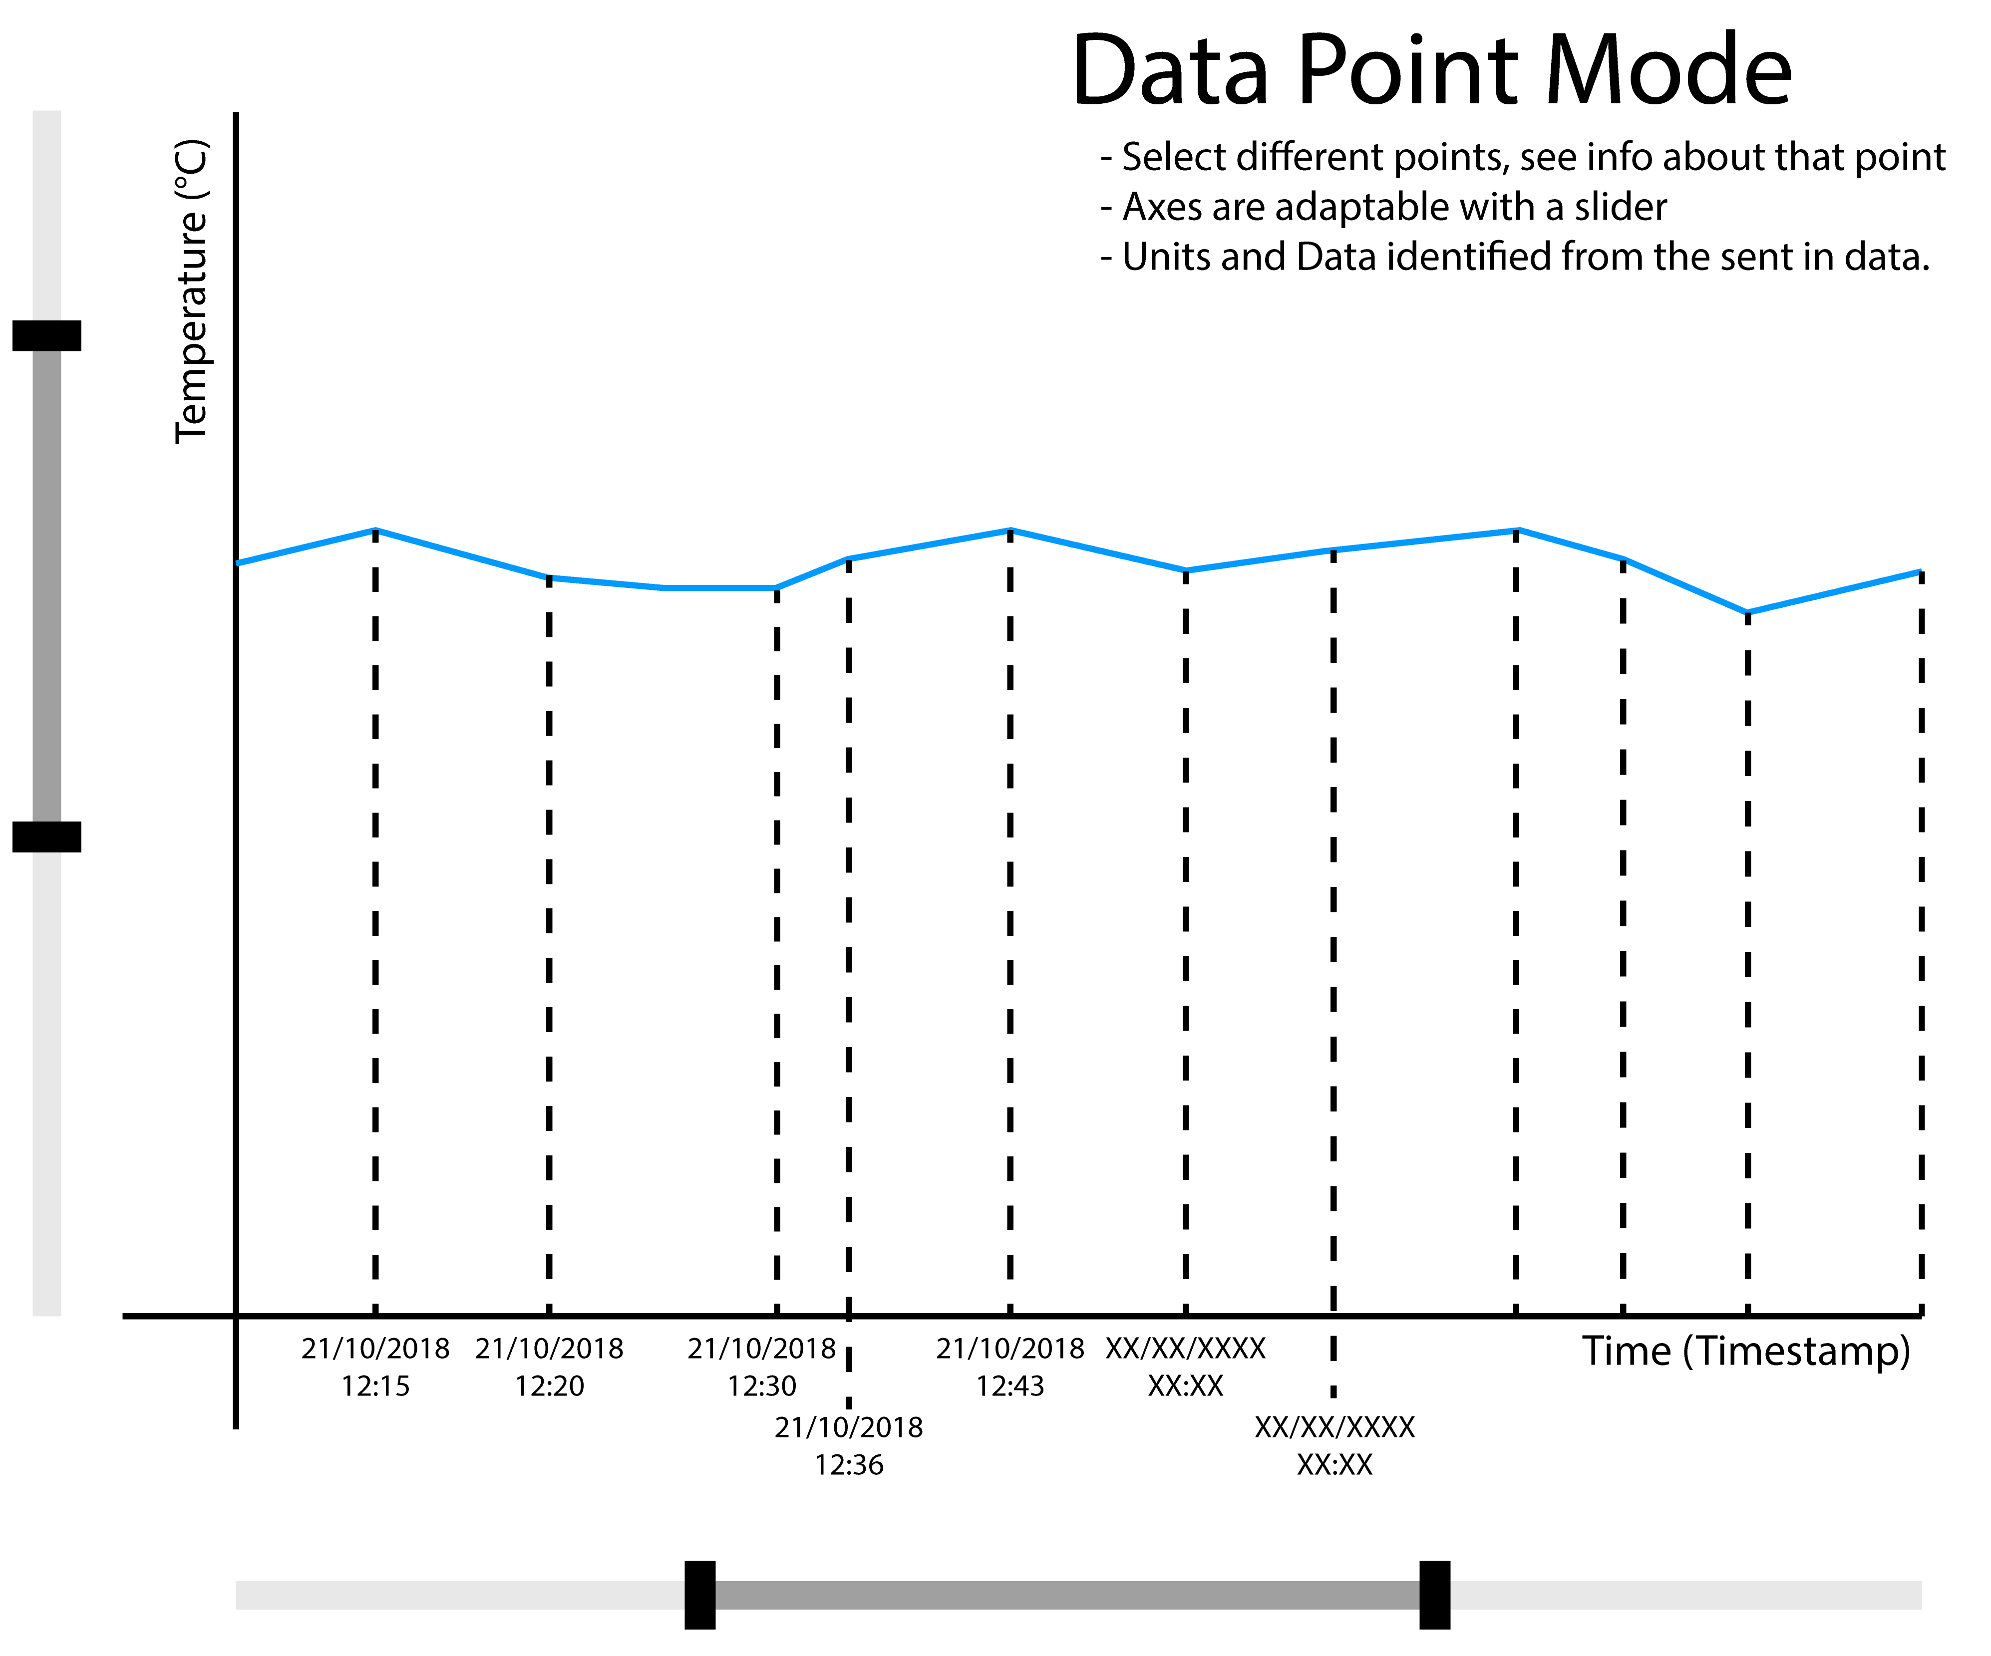
Difficult Things 2018 – Joris Lodewijks

Slide 8
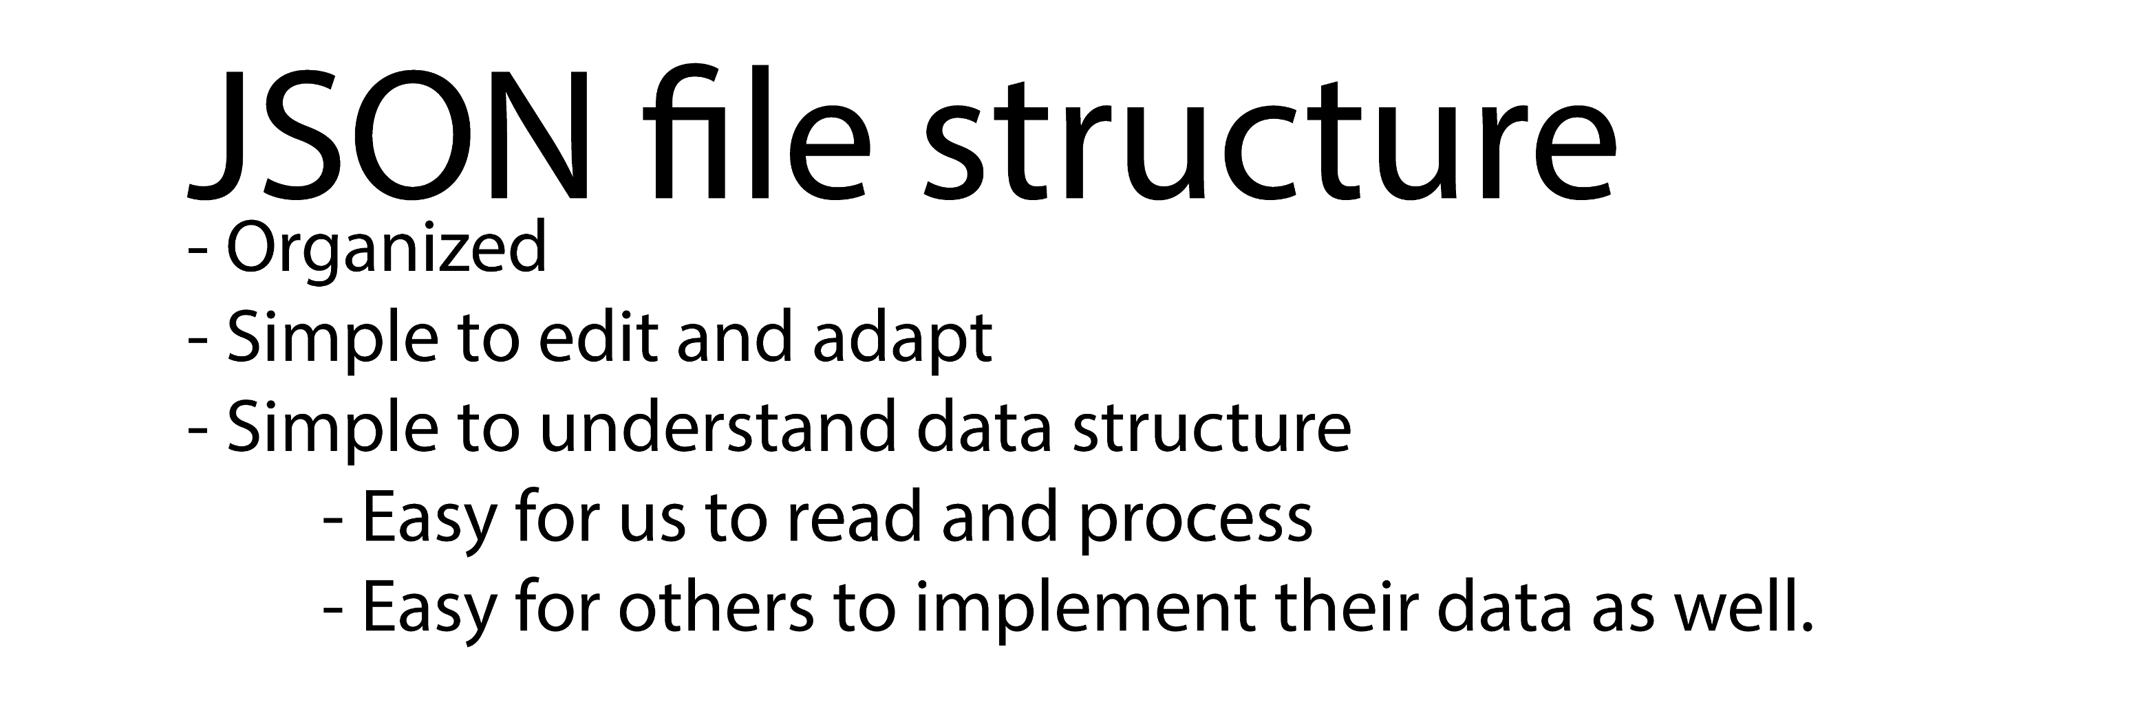
Difficult Things 2018 – Joris Lodewijks

Slide 9
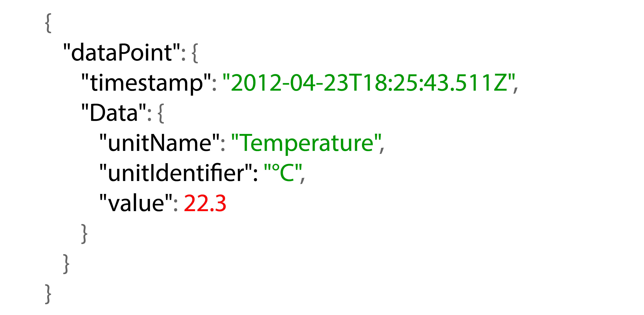
Data Point Example – JSON formatting
Difficult Things 2018 – Joris Lodewijks

Slide 10
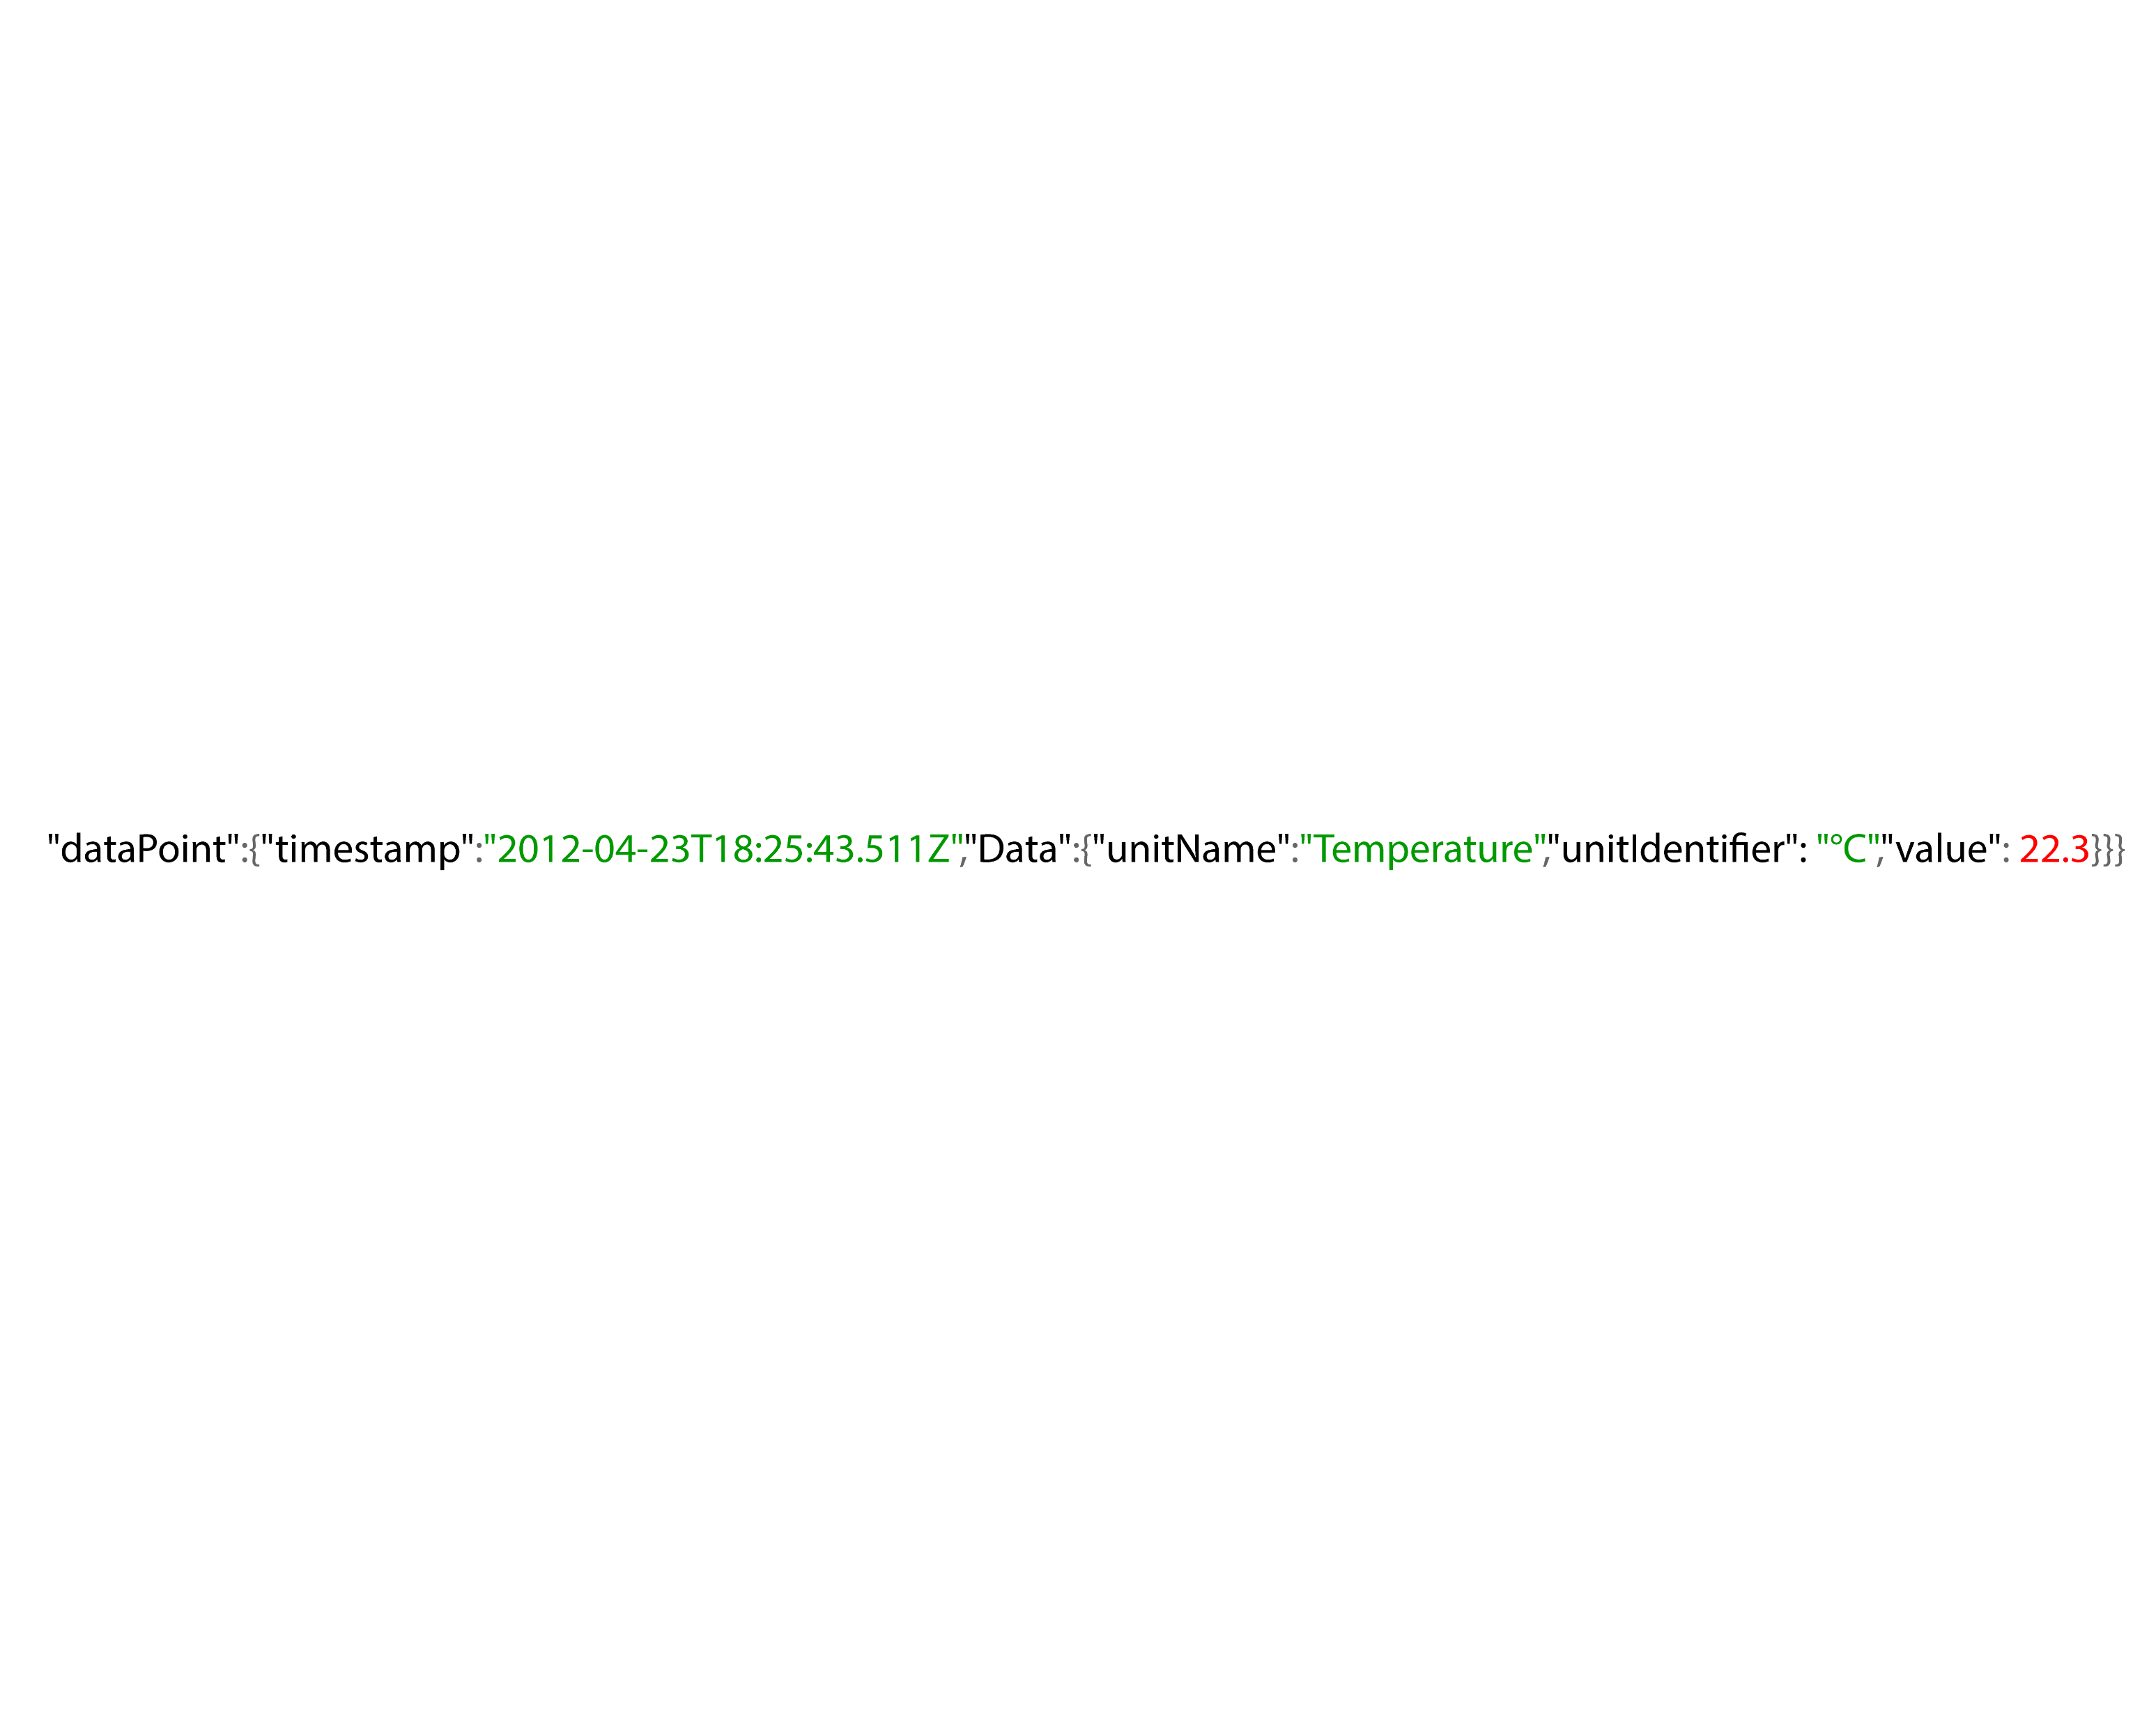
Data Point Example – JSON formatting
Compact one line – format for internal code
Difficult Things 2018 – Joris Lodewijks

Slide 11
Position Specific Data (PSD)
For example, Lucid Bar, Work Spaces…
Make a general Location Map Template
Difficult Things 2018 – Joris Lodewijks

Slide 12
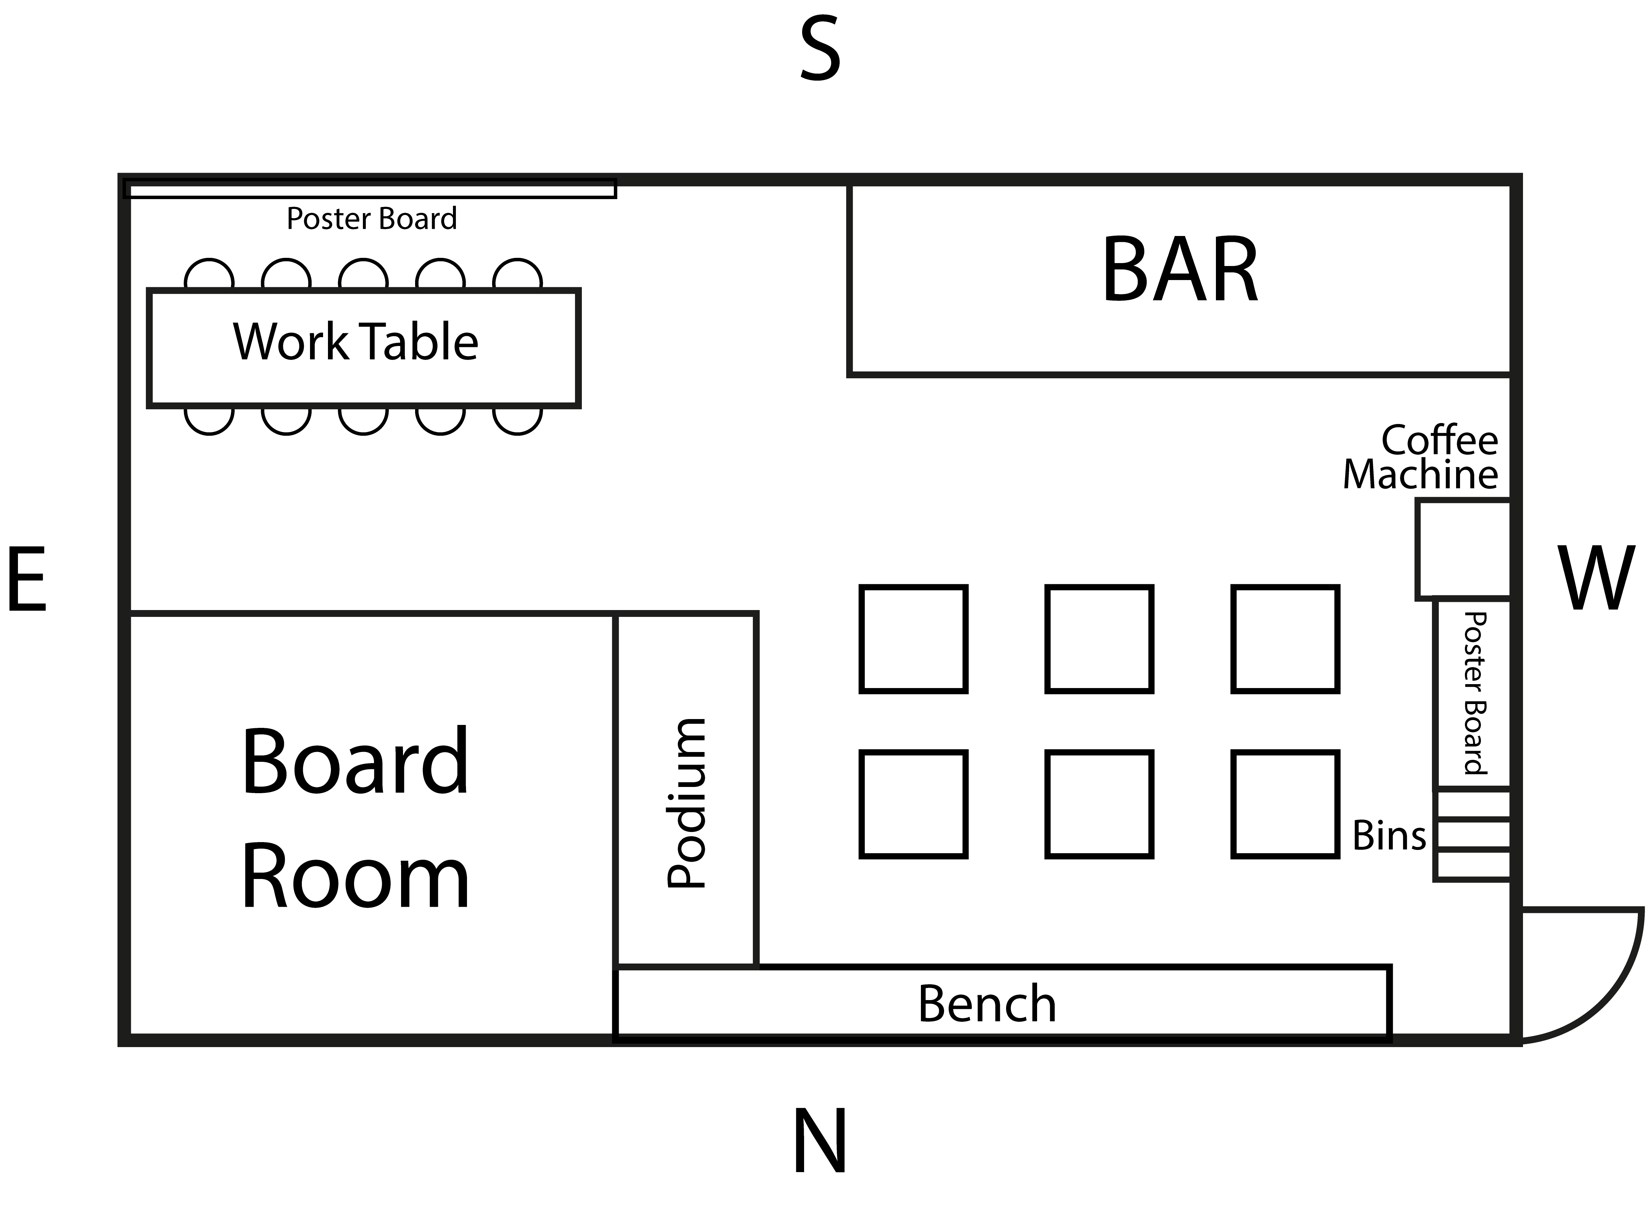
Position Specific Data (PSD)
For example, Lucid Bar, Work Spaces…
Difficult Things 2018 – Joris Lodewijks

Slide 13
Position Specific Data (PSD)
For example, Lucid Bar, Work Spaces…
Quick reference map, important locations are listed here.
Sensor Developers on pow(3, L) can use this template for location/position specific data.
Difficult Things 2018 – Joris Lodewijks

Slide 14
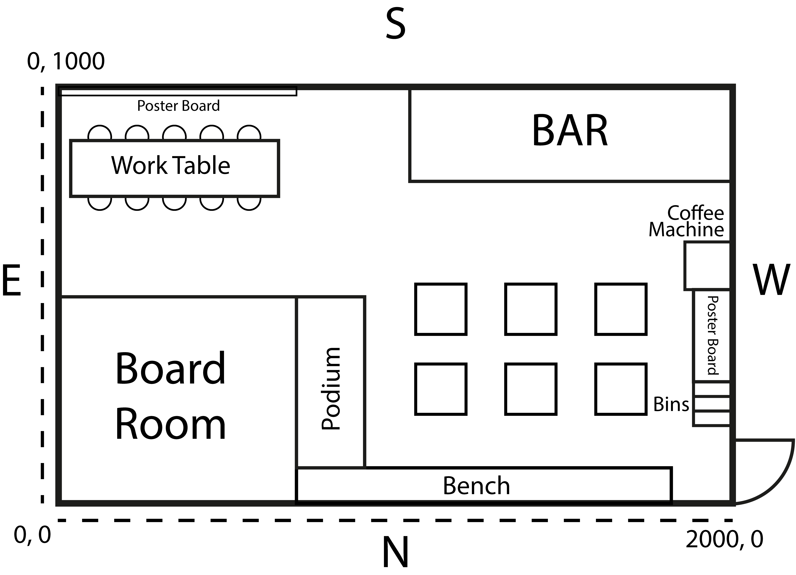
Position Specific Data (PSD)
For example, Lucid Bar, Work Spaces…
Quick reference map, important locations are listed here.
Sensor Developers on pow(3, L) can use this template for location/position specific data.
Difficult Things 2018 – Joris Lodewijks

